Slide 1
Product Management System and Market Analysis
Bhavya hingorani (9)
Rohan Padhye (29)
Raghuttam Parvatikar (34)

Slide 2
Problem statement.
To bring clarity among the consumers about the purity of the product they are consuming, also providing important market analysis to clients that will help them understand the market better. A model that covers both the sections of the business.

Slide 3
Scope of Project & need of project
Scope of our project is limitless, when considered its true potential. Our project can set new standard to quality norms to whole of FMCG market. From a small packet of Lays to as big as Organic Farming industry. It will also transform the current financial calculation system to a much efficient one.
Today’s products have decremented in terms of quality and trust wise. As we move foreword, we have to develop a technology that addresses product security which helps in getting safe products to the consumers.

Slide 4
Literature Survey
Blockchain — Publisher IEEE
Candel, J.J.L. (2014) Food security governance: a systematic literature review, Food Security, 6, 585-601
Automated analysis of feature models 20 years later: A literature review – ELSEVIER
Research on animal health and welfare in organic farming - ELSEVIER

Slide 5
Project flow diagram
Prediction Model
ENTER ID
Customer
Home
Client
LOGIN
Product Details
Data Visualisation

Slide 6
Technologies used.
Front End: Streamlit-0.82.0 framework
Data Visualisation: Pandas, Numpy, matplotlib, plotly, altair
Back End: SQL

Slide 7
What did we do different?
Streamlit was a discovery by mistake, it helps to improve the front end tasks.
Our system is open to blockchain integration.
There are not many technologies that provide solution to product security and quality, so our project stand out in that criteria.
We tried different plot libraries, to make our graph look more interesting and likeble.

Slide 8
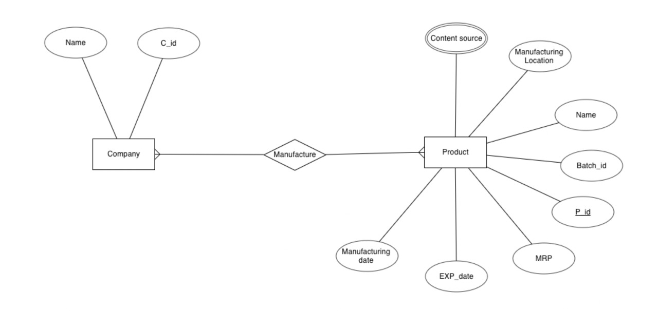
Er diagram

Slide 9
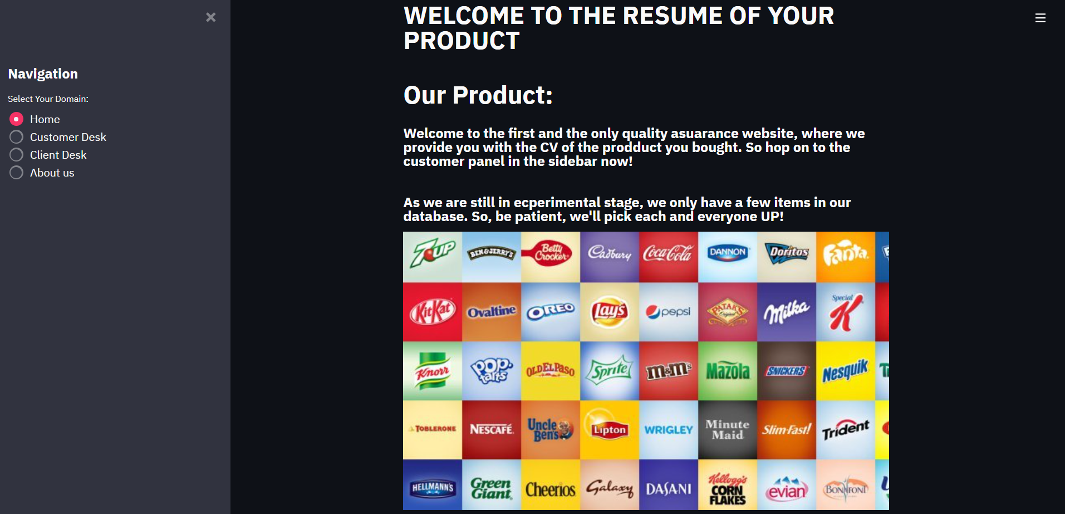
Our front-end design (GUI)

Slide 10
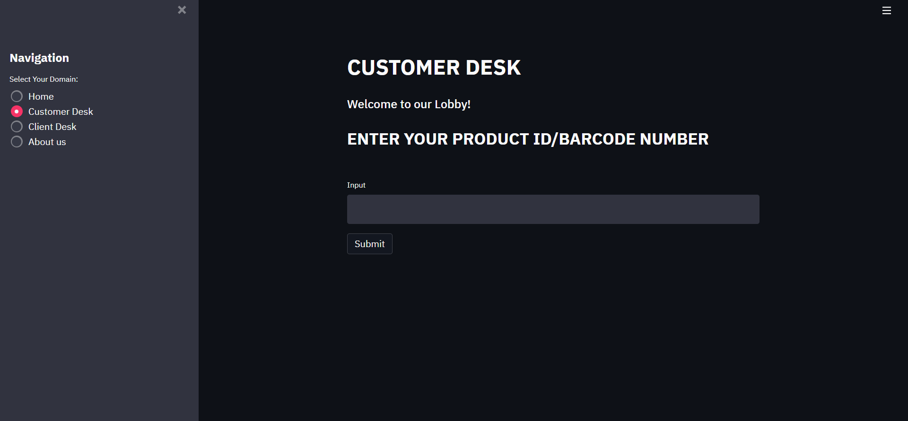
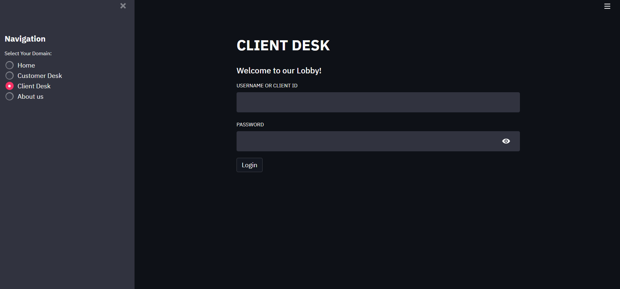

Slide 11
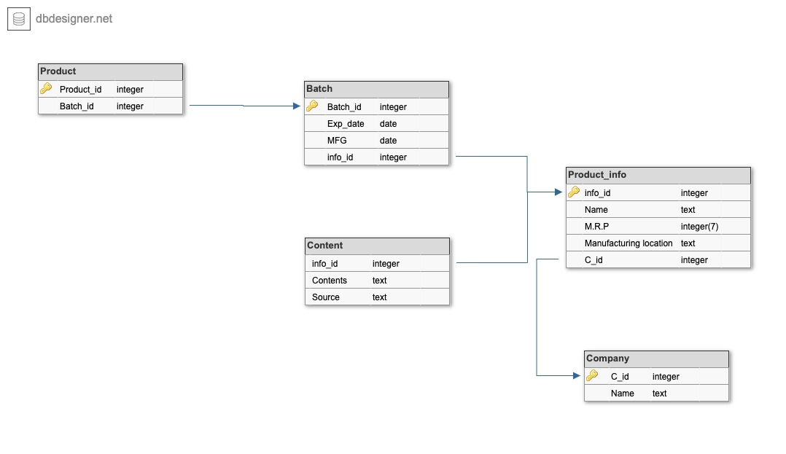
Our back-end design (Database & Relationship models)

Slide 12
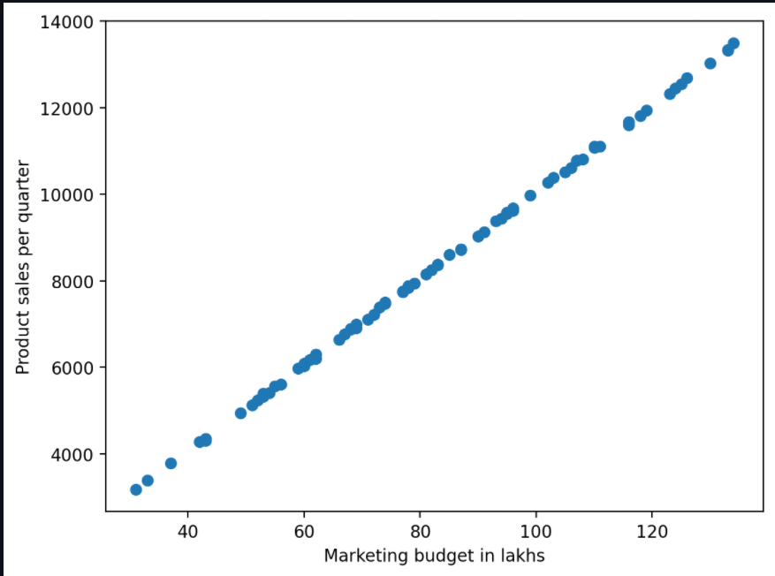
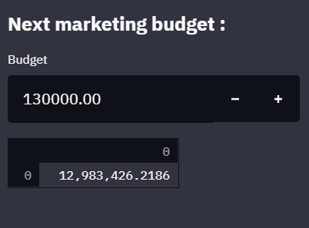
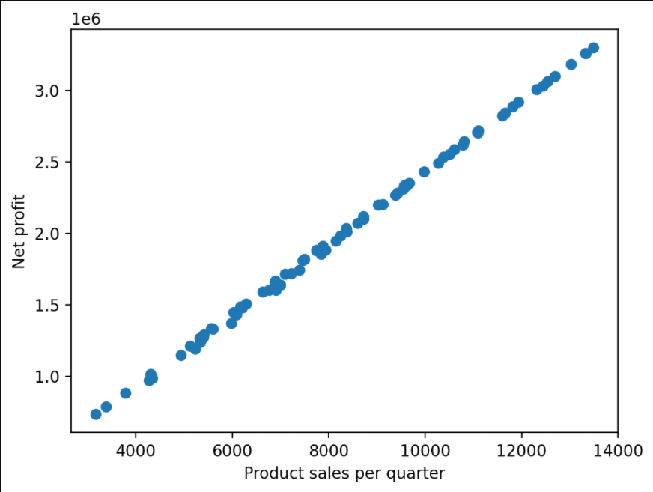
Result-I
Prediction Module using
Linear Regression

Slide 13
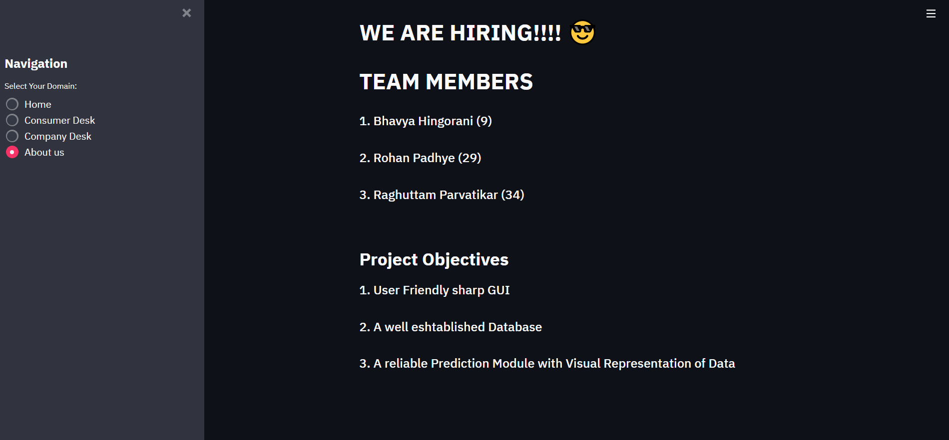
Result-II

Slide 14
Conclusion
What we have created is a really small part of a major project. This can also be classified as the first step towards reaching the goal i.e. Product Quality Assurance and Client Database.

